Slide 1

Go, change the world
RV College of
Engineering
Unit -1
Introduction to Programming

Slide 2

Go, change the world
RV College of
Engineering
Contents
Definition of a computer
Components of computer system
Programming Languages
Design and implementation of efficient programs
Program Design Tools: Algorithms, Flowcharts and Pseudocodes.
Types of Errors

Slide 3

Go, change the world
RV College of
Engineering
Definition of a computer:
A computer is an electronic device that is designed
to accept data
perform the required mathematical and logical operations
and output the result.

Slide 4
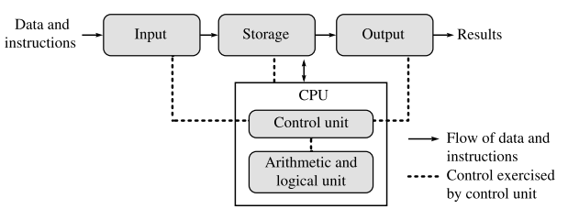
Go, change the world
RV College of
Engineering
Basic Computer Organization
A computer is an electronic device that performs five major operations:
Accepting data or instructions (input) : keyboard, mouse, scanner, trackball
Storing data: primary and secondary memory
Processing data: CU and ALU
Displaying results (output): Monitor, printer
Controlling and coordinating all operations inside a computer

Slide 5
Go, change the world
COMPONENTS OF A COMPUTER SYSTEM
RV College of
Engineering
Component #1 : Hardware
Hardware of a computer system includes:
Memory
Hard Disks
Processor
Peripheral Devices/Input and Output Devices

Slide 6
Go, change the world
RV College of
Engineering
Memory
Primary memory
RAM (volatile storage area): Static RAM , Dynamic RAM
ROM (non-volatile): BIOS
Rewritable ROM chips: PROM (one time programmable), EPROM (erasable and reprogrammable), EEPROM (Electrically erasable programmable )camera, MP3 player.
Secondary memory
Hard disks- formatted according to a file system that organizes the data into files and directories

Slide 7
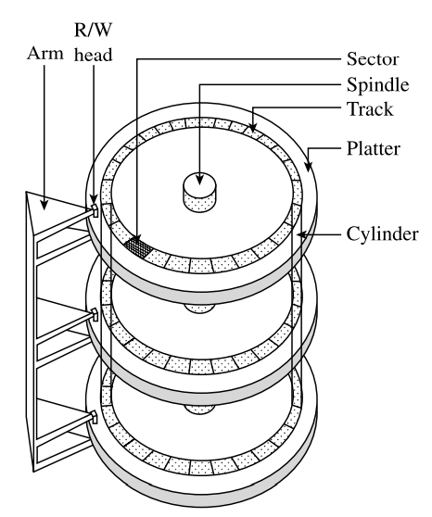
Go, change the world
RV College of
Engineering
Hard Disks
The hard drive is a part of the computer that stores all the programs and files,
if the drive is damaged for some reason, all the data stored on the computer is lost.
A hard disk is basically a set of disks, stacked together like phonograph records, that has data recorded electromagnetically in concentric circles known as tracks
A single hard disk includes several platters (or disks) that are covered with a magnetic recording medium.
Each platter requires two read/write (R/W) heads, one for each side.
The R/W head can pivot back and forth over the platters to read or write data on them.
Data is actually stored on the surface of a platter in sectors and tracks

Slide 8
Go, change the world
RV College of
Engineering
The performance of a hard disk depends on its access time, which is the time required to read or write on the disk.
Access time is a combination of the following three components:
Seek time This is the time taken to position the R/W head over the appropriate cylinder (usually around 8 ms on an average)
Rotational delay This is the time taken to bring the target sector to rotate under the R/W head
Transfer time The time to transfer data or read/write to a disk is called the transfer rate
overall time required to access data = seek time + rotational delay + transfer time
The sum of the seek time and the rotational delay is also known as disk latency.
Disk latency is the time taken to initiate a transfer.

Slide 9
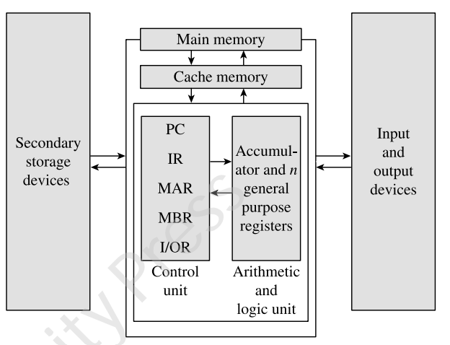
Go, change the world
RV College of
Engineering
Processor
A basic processor consists of two main parts
—ALU and control unit (CU).
It also registers, an execution unit, and a bus interface unit (BIU).
Execution unit The execution unit mainly consists of the CU, ALU, and registers

Slide 10
Go, change the world
RV College of
Engineering
Control unit: The main function of the CU is to direct and coordinate the computer operations.
It interprets the instructions (program) and initiates action to execute them.
The CU controls the flow of data through the computer system and directs the ALU, registers, buses, and input/output (I/O) devices.
The CU controls all operations within the processor, which in turn controls all other parts of the computer system.
In addition, the CU is responsible for fetching, decoding, executing instructions, and storing results.
Arithmetic and logic unit
The ALU performs
arithmetic (add, subtract, multiply, divide, etc.),
comparison (less than, greater than, or equal to), and other operations.
-

Slide 11
Go, change the world
RV College of
Engineering
Registers:
A processor register is a computer memory that provides quick access to the data currently being used for processing.
The ALU stores all temporary results and the final result in the processor registers
There are different types of registers, each with a specific storage function:
Accumulator and general purpose registers: to store the data brought from the main memory and the intermediate results
Special purpose registers – memory address register (MAR), memory buffer register (MBR), instruction register (IR), the I/O register, program counter (PC)
Instruction cycle: set of basic operations to execute an instruction

Slide 12
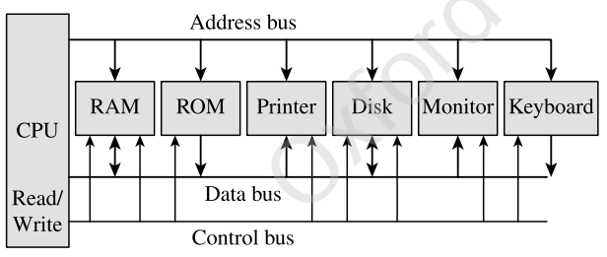
Go, change the world
RV College of
Engineering
Bus interface unit:
The BIU provides functions for transferring data between the execution unit of the CPU and other components of the computer system that lie outside the CPU.
Every computer system has three different types of busses to carry information from one part to the other. These are the data bus, control bus, and address bus

Slide 13
Go, change the world
RV College of
Engineering
The BIU puts the contents of the program counter on the address bus.
Once the memory receives an address from the BIU, it places the contents at that address on the data bus, which is then transferred to the IR of the processor through the MBR.
At this time, the contents of the program counter are modified (e.g., incremented by 1) so that it now stores the address of the next instruction

Slide 14
Go, change the world
RV College of
Engineering
Instruction set The instruction set is a set of commands that instructs the processor to perform specific tasks
System clock A small quartz crystal circuit called the system clock controls the timing of all operations within the computer system
Processor speed The speed of PCs and minicomputers is usually specified in MHz or GHz, what about mainframes and supercomputers?
Pipelining and parallel processing : Pipelining is a technique with which the processor can fetch the second instruction before completing the execution of the first instruction. Such processors that can execute more than one instruction per clock cycle are called superscalar processors

Slide 15
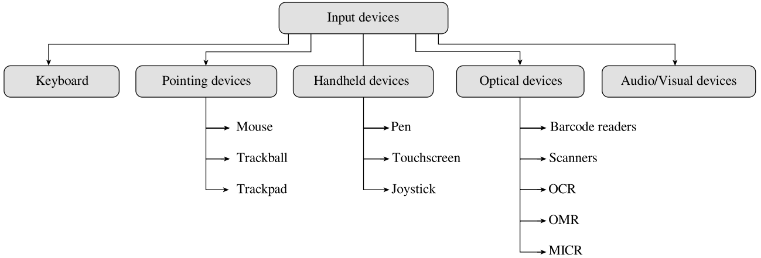
Go, change the world
RV College of
Engineering
Peripheral Devices/Input and Output Devices
Need input and output devices for computers to be able to interact with its users
There are different types of input/output devices, and each device has capabilities that differentiate it from the others.

Slide 16
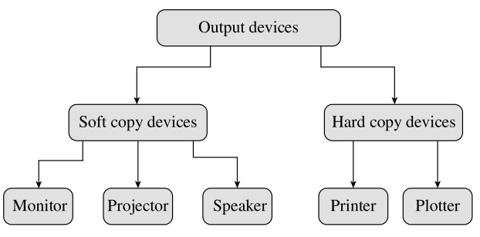
Go, change the world
RV College of
Engineering
Input Devices An input device is used to feed data and instructions into the computer.
Output Devices Any device that outputs/gives information from a computer can be called an output device.

Slide 17
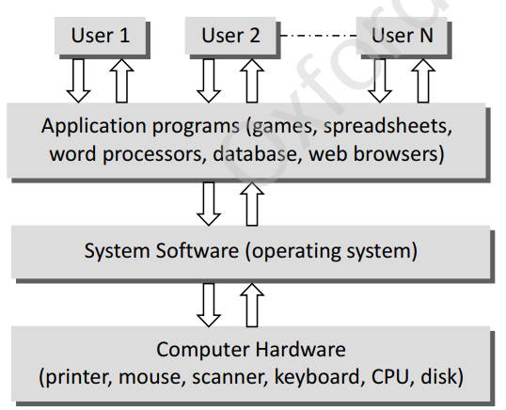
Go, change the world
RV College of
Engineering
2. Component #2 : Software
Computer software can be broadly classified into two groups:
system software and
application software.
System software : provides a general programming environment in which programmers can create specific applications to suit their needs.
This environment provides new functions that are not available at the hardware level and performs tasks related to execution of application programs.
Application software is designed to solve a particular problem for users.
Allow users to do something besides simply running the hardware

Slide 18
Go, change the world
RV College of
Engineering
System Software :
System software is software designed to operate the computer hardware and to provide and maintain a platform for running application software.
The most widely used system software are:
Computer BIOS and Device Drivers : BIOS is stored on a ROM chip built into the system.
The key role of BIOS is to load and start the operating system. the code in the BIOS chip runs a series of tests called POST (Power On Self Test) to ensure that the system devices are working correctly. BIOS then locates software held on a peripheral device such as a hard disk or a CD, and loads and executes that software, giving it control of the computer. This process is known as booting

Slide 19
Go, change the world
RV College of
Engineering
To summarize, BIOS performs the following functions:
Initializes the system hardware
Initializes system registers
Initializes power management system
Tests RAM
Tests all the serial and parallel ports
Initializes CD/DVD drive and hard disk controllers
Displays system summary information

Slide 20
Go, change the world
RV College of
Engineering
2. Operating System (OS):
The primary goal of an operating system is to make the computer system (or any other device in which it is installed like a cell phone) convenient and efficient to use.
Offers generic services to support user applications.
Ensures that the system resources (such as CPU, memory, I/O devices) are utilized efficiently
OS - to have a control policy and algorithm to allocate the system resources.

Slide 21
Go, change the world
RV College of
Engineering
3.Utility Software:
Utility software is used to analyze, configure, optimize, and maintain the computer system.
Utility programs may be requested by application programs during their execution for multiple purposes.
Some of them are as follows:
Disk defragmenters, Disk checkers, Disk cleaners, Disk space analysers, Disk partitions utilities,
Backup utilities, Disk compression utilities, File managers, System profilers, Anti-virus utilities , Data compression utilities,
Cryptographic utilities, Launcher applications, Registry cleaners, Network utilities, Command line interface (CLI) and
Graphical user interface (GUI).

Slide 22
Go, change the world
RV College of
Engineering
4. Compiler, Interpreter, Linker, and Loader
Compiler:
It is a special type of program that transforms the source code written in a programming language (the source language) into machine language comprising just two digits, 1s and 0s (the target language).
The resultant code in 1s and 0s is known as the object code.
The object code is the one which will be used to create an executable program.
Interpreter
The interpreter, on the other hand, translates the instructions into an intermediate form, which it then executes.
interpreter interprets the source code line by line
Linker(link editor binder) It is a program that combines object modules to form an executable program. The compiler automatically invokes the linker as the last step in compiling a program, to put together all the submodules object codes together.
Loader It is a special type of program that copies programs from a storage device to main memory, where they can be executed.

Slide 23
Go, change the world
RV College of
Engineering
Application Software:
Application software is a type of computer software that employs the capabilities of a computer directly to perform a user-defined task.
Typical examples of software applications are word processors, spreadsheets, media players, education software, CAD, CAM, data communication software, and statistical and operational research software

Slide 24
Go, change the world
PROGRAMMING LANGUAGES
RV College of
Engineering
A programming language is a language specifically designed to express computations that can be performed by the computer.
Programming languages are used to create programs that control the behaviour of a system, to express algorithms, or as a mode of human–computer communication.
programming languages have a vocabulary of syntax and semantics for instructing a computer to perform specific tasks.
The term programming language usually refers to high-level languages, such as BASIC, C, C++, COBOL, FORTRAN

Slide 25
Go, change the world
RV College of
Engineering
While high-level programming languages are easy for humans to read and understand, the computer actually understands the machine language that consists of numbers only.
Each type of CPU has its own unique machine language
In between the machine languages and high-level languages, there is another type of language known as assembly language.
Assembly languages are similar to machine languages, but they are much easier to program because they allow a programmer to substitute names for numbers.
There are two ways to convert the program written using any programming language into machine language is: compile the program or interpret the program

Slide 26
Go, change the world
RV College of
Engineering
The question of which language is the best depends on the following factors:
The type of computer on which the program has to be executed
The type of program
The expertise of the programmer

Slide 27
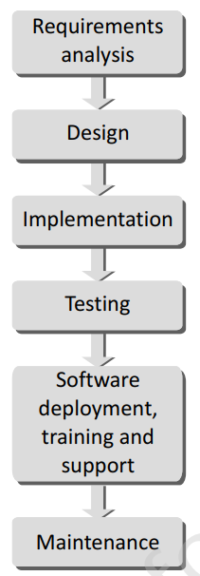
Go, change the world
RV College of
Engineering
DESIGN AND IMPLEMENTATION OF EFFICIENT PROGRAMS
The entire program or software (collection of programs) development process is divided into a number of phases where each phase performs a well-defined task
The output of one phase provides the input for its subsequent phase.

Slide 28
Go, change the world
RV College of
Engineering
DESIGN AND IMPLEMENTATION OF EFFICIENT PROGRAMS
Requirements Analysis:
All the gathered users’ requirements are analysed to pen down the scope or the objective of the overall software product.
Documenting every identified requirement of the users in order to avoid any doubts or uncertainty regarding the functionality of the programs.
The functionality, capability, performance, availability of hardware and software components are all analysed in this phase

Slide 29
Go, change the world
RV College of
Engineering
Design:
A plan of actions is made before the actual development process could start.
This plan will be followed throughout the development process.
In the design phase the core structure of the software/program is broken down into modules.
The solution of the program is then specified for each module in the form of algorithms, flowcharts, or pseudocodes.
The design phase, therefore, specifies how the program/software will be built.

Slide 30
Go, change the world
RV College of
Engineering
Implementation:
The designed algorithms are converted into program code using any of the high level languages.
The particular choice of language will depend on the type of program like whether it is a system or an application program.
The program codes are tested by the programmer to ensure their correctness. This phase is also called construction or code generation phase as the code of the software is generated in this phase.
While constructing the code, the development team checks whether the software is compatible with the available hardware and other software components that were mentioned in the Requirements Specification Document created in the first phase.

Slide 31
Go, change the world
RV College of
Engineering
Testing
In this phase, all the modules are tested together to ensure that the overall system works well as a whole product.
Integration testing is done in this phase.
Testing is done to ensure that the software is working as expected by the users’ requirements that were identified in the requirements analysis phase.
Software Deployment, Training, and Support
After the code is tested and the software or the program has been approved by the users, it is then installed or deployed in the production environment.
Software Training and Support is a crucial phase which is often ignored by most of the developers to use and fix up small errors

Slide 32
Go, change the world
RV College of
Engineering
Maintenance
Maintenance and enhancements are ongoing activities which are done to cope with newly discovered problems or new requirements.
Such activities may take a long time to complete as the requirement may call for addition of new code that does not fit the original design or an extra piece of code required to fix an unforeseen problem.
As a general rule, if the cost of the maintenance phase exceeds 25% of the prior-phases cost then it clearly indicates that the overall quality of at least one prior phase is poor.
In such cases, it is better to re-build the software (or some modules) before maintenance cost is out of control.

Slide 33
Go, change the world
RV College of
Engineering
PROGRAM DESIGN TOOLS
1 Algorithms: an algorithm provides a blueprint to writing a program to solve a particular problem.
It is considered to be an effective procedure for solving a problem in a finite number of steps.
Algorithms are mainly used to achieve software reuse.
Blue print can be implemented in any high-level language, such as C, C++, Java, and so on.

Slide 34
Go, change the world
RV College of
Engineering
Algorithm Characteristics
Be precise
Be unambiguous
Not even a single instruction must be repeated infinitely
After the algorithm gets terminated, the desired result must be obtained

Slide 35
Go, change the world
RV College of
Engineering
Control Structures used in Algorithms
An algorithm has a finite number of steps and some steps may involve decision-making and repetition.
Broadly speaking, an algorithm can employ any of the three control structures, namely,
Sequence: Sequence means that each step of the algorithm is executed in the specified order
Decision: Decision statements are used when the outcome of the process depends on some condition.
Repetition: which involves executing one or more steps for a number of times, can be implemented using constructs such as while, do-while, and for loops.

Slide 36
Go, change the world
RV College of
Engineering
Example
Here is an example of an algorithm, for making a pot of tea.
1. If the kettle does not contain water, then ﬁll the kettle.
2. Plug the kettle into the power point and switch it on.
3. If the teapot is not empty, then empty the teapot.
4. Place tea leaves in the teapot.
5. If the water in the kettle is not boiling, then go to step 5.
6. Switch off the kettle.
7. Pour water from the kettle into the teapot.

Slide 37
Go, change the world
RV College of
Engineering
Write the algorithm for ﬁnding the sum of any two numbers.
1. START
2. PRINT “ENTER TWO NUMBERS”
3. INPUT A, B
4. C ← A + B
5. PRINT C
6. STOP

Slide 38
Go, change the world
RV College of
Engineering
Construct the algorithm for interchanging the numeric values of two variables.
1. START
2. PRINT “ENTER THE VALUE OF A & B”
3. INPUT A, B
4. C ←A
5. A ← B
6. B ← C
7. PRINT A, B
8. END

Slide 39
Go, change the world
RV College of
Engineering
Write an algorithm that compares two numbers and prints either
the message identifying the greater number or the message
stating that both numbers are equal.
1. START
2. PRINT “ENTER TWO NUMBERS”
3. INPUT A, B
4. IF A > B THEN
PRINT “A IS GREATER THAN B”
5. IF B > A THEN
PRINT “B IS GREATER THAN A”
6. IF A = B THEN
PRINT “BOTH ARE EQUAL”
7. STOP

Slide 40
Go, change the world
RV College of
Engineering
Construct an algorithm for incrementing the value of a variable
that starts with an initial value of 1 and stops when the value
becomes 5.
1. START
2. C ←1
3. WHILE C <= 5
4. BEGIN
5. PRINT C
6. C ←C + 1
7. END
8. STOP

Slide 41
Go, change the world
RV College of
Engineering
Selecting the Most Efficient Algorithm Many a times, you may formulate more than one algorithm for a problem. In such cases, you must always analyse all the alternatives and try to choose the most efficient algorithm.
This can be done by time and space complexity of the algorithms designed.
The time complexity of an algorithm is basically the running time of a program as a function of the input size. Similarly, the space complexity of an algorithm is the amount of computer memory that is required during the program execution as a function of the input size.

Slide 42
Go, change the world
RV College of
Engineering
2 Flowcharts
A flowchart is a graphical or symbolic representation of a process.
It is basically used to design and document virtually complex processes to help the viewers to visualize the logic of the process, so that they can gain a better understanding of the process and find flaws bottlenecks, and other less obvious features within it.
When designing a flowchart, each step in the process is depicted by a different symbol and is associated with a short description.
The symbols in the flowchart are linked together with arrows to show the flow of logic in the process.

Slide 43
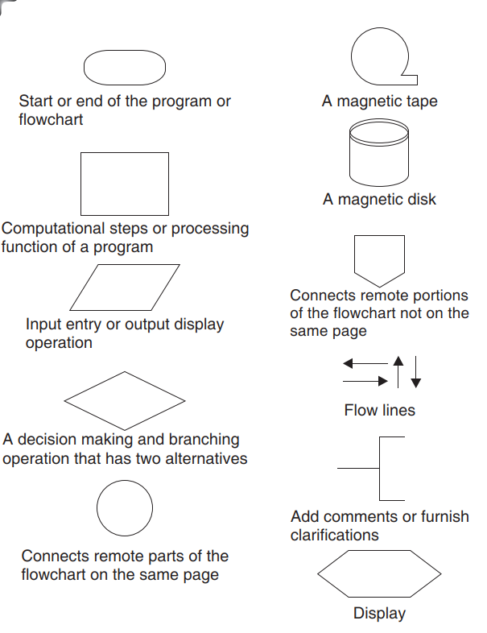
Go, change the world
RV College of
Engineering
.

Slide 44
Go, change the world
RV College of
Engineering
The symbols of a flowchart include:
Start and end symbols
Arrows
Generic processing step
Input/output symbols
conditional or decision symbol
Labelled connectors
Refer for the flowchart ad algorithms in the text book.

Slide 45
Go, change the world
RV College of
Engineering
The symbols of a flowchart include:
Start and end symbols
Arrows
Generic processing step
Input/output symbols
conditional or decision symbol
Labelled connectors
Refer for the flowchart ad algorithms in the text book.

Slide 46
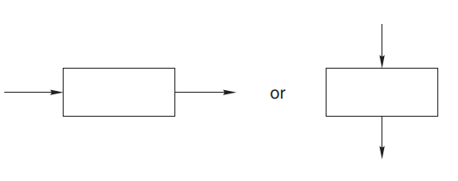
Flowcharts
The following are some guidelines in ﬂowcharting.
In drawing a proper ﬂowchart, all necessary requirements should be listed out in a logical order.
There should be a logical start and stop to the ﬂowchart.
The ﬂowchart should be clear, neat, and easy to follow.
There should be no ambiguity in understanding the ﬂowchart.
The usual direction of the ﬂow of a procedure or system is from left to right or top to bottom.
Only one ﬂow line should emerge from a process symbol.

Slide 47
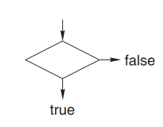
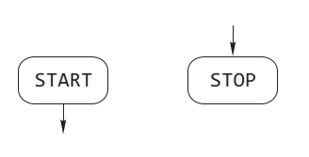
Flowcharts
Only one ﬂow line should enter a decision symbol, but two or three ﬂow lines, one for each possible answer, can leave the decision symbol.
Only one ﬂow line is used in conjunction with a terminal symbol.
The writing within standard symbols should be brief.

Slide 48
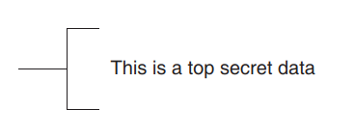
Flowcharts
If necessary, the annotation symbol can be used to describe data or computational steps more clearly.
If the ﬂowchart becomes complex, connector symbols should be used to reduce the number of ﬂow lines.
The intersection of ﬂow lines should be avoided to make the ﬂowchart a more effective and better way of communication.

Slide 49
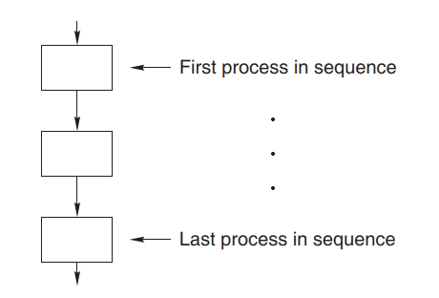
Flowcharts
The validity of the ﬂowchart should be tested by passing simple test data through it.
A sequence of steps or processes that are executed in a particular order is shown using process symbols connected with ﬂow lines.
One ﬂow line enters the ﬁrst process while one ﬂow line emerges from the last process in the sequence.

Slide 50
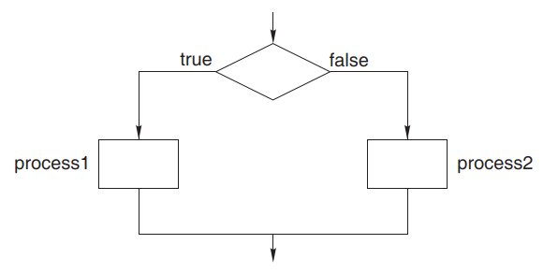
Flowcharts
Selection of a process or step is depicted by the decision making and process symbols.
Only one input indicated by one incoming ﬂow line and one output ﬂowing out of this structure exists.
The decision symbol and the process symbols are connected by
ﬂow lines.

Slide 51
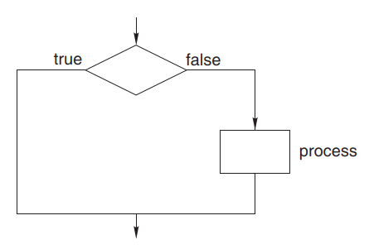
Flowcharts
Iteration or looping is depicted by a combination of process and decision symbols placed in proper order.
Here ﬂow lines are used to connect the symbols and depict input and output to this structure.

Slide 52
Flowcharts
Advantages of using ﬂowcharts
Communication: Flowcharts are a better way of communicating the logic of a system to all concerned.
Effective analysis: With the help of ﬂowcharts, problems can be analyzed more effectively.
Proper documentation: Program ﬂowcharts serve as a good program documentation needed for various purposes.
Efﬁcient coding: Flowcharts act as a guide or blueprint during the systems analysis and program development phase.
Proper debugging: Flowcharts help in the debugging process.
Efﬁcient program maintenance: The maintenance of an operating program becomes easy with the help of a ﬂowchart.

Slide 53
Flowcharts
Limitations of using ﬂowcharts
Complex logic: Sometimes, the program logic is quite complicated.
in such a case, a ﬂowchart becomes complex and clumsy.
Alterations and modiﬁcations: If alterations are required, the
ﬂowchart may need to be redrawn completely.
Reproduction: Since the ﬂowchart symbols cannot be typed in, the
reproduction of a ﬂowchart becomes a problem.
Loss of objective: The essentials of what has to be done can easily
be lost in the technical details of how it is to be done.

Slide 54
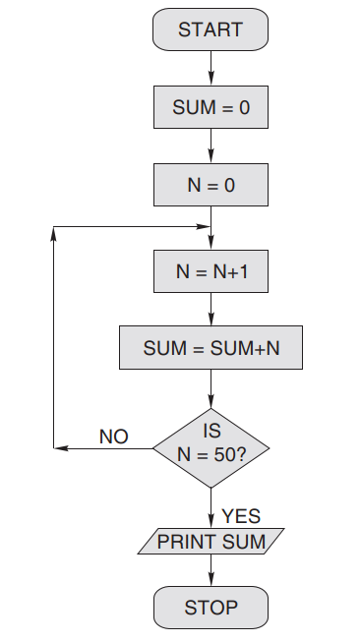
Flowcharts
Draw a ﬂowchart to ﬁnd the sum of the ﬁrst 50 natural
numbers.

Slide 55
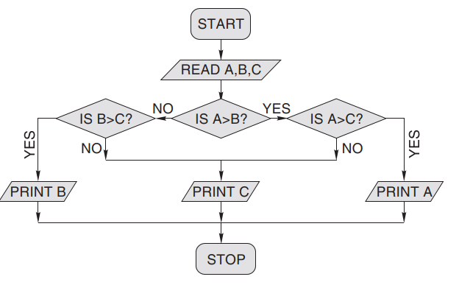
Flowcharts
Draw a ﬂowchart to ﬁnd the largest of three numbers A, B,
and C.

Slide 56
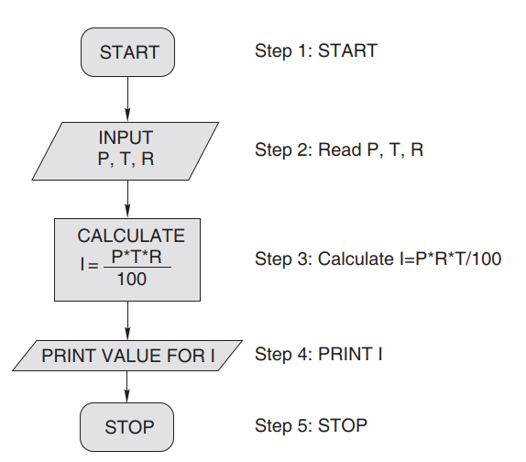
Flowcharts
Draw a ﬂowchart for calculating the simple interest using the formula SI = (P * T * R)/100, where P denotes the principal amount, T time, and R rate of interest. Also, show the algorithm in step-form.

Slide 57
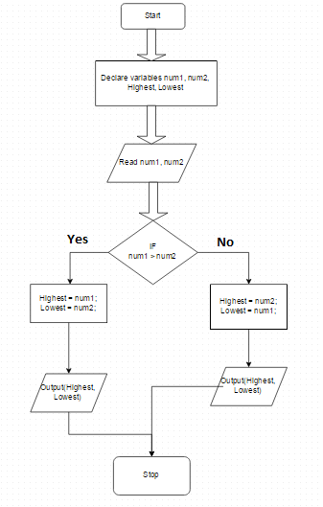
Flowcharts

Slide 58
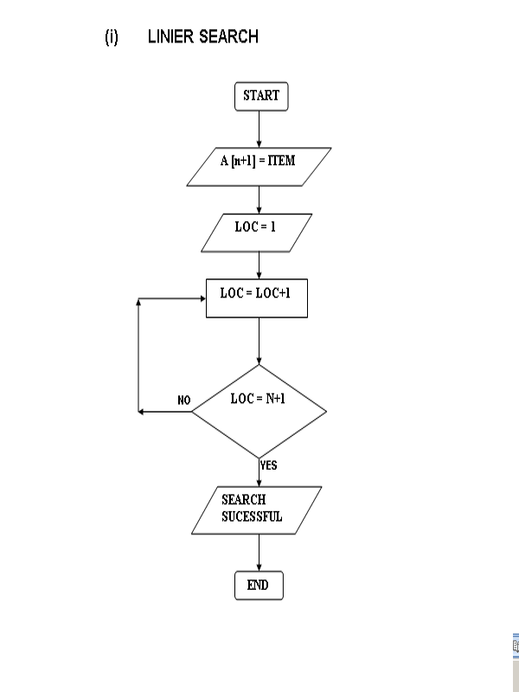
Flowcharts

Slide 59
Go, change the world
RV College of
Engineering
3 Pseudocodes
Pseudocode is a compact and informal high-level description of an algorithm that uses the structural conventions of a programming language.
Pseudocodes are an outline of a program that can be easily converted into programming statements.
They consist of short English phrases that explain specific tasks within a program’s algorithm. They should not include keywords in any specific computer language.
The sole purpose of pseudocodes is to enhance human understandability of the solution.
They are commonly used in textbooks and scientific publications for documenting algorithms, and for sketching out the program structure before the actual coding is done
There are no standards defined for writing a pseudocode, because a pseudocode is not an executable program.
Flowcharts can be considered as graphical alternatives to pseudocodes, but require more space on paper.

Slide 60
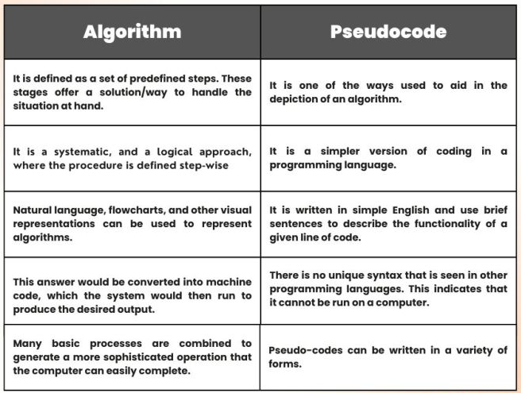
Go, change the world
RV College of
Engineering

Slide 61
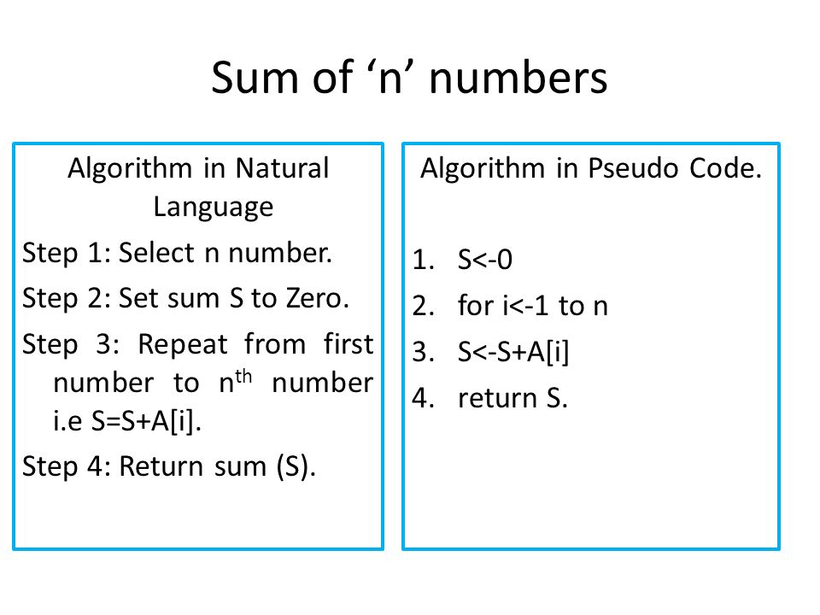
Go, change the world
RV College of
Engineering

Slide 62
Go, change the world
RV College of
Engineering
Factorial of a Number
Algorithm
Step 1: start
Step 2: initialize fact = 1
Step 3: input from the user value n
Step 4: for i=1 to i <= n repeat the process
Step 5: fact = fact * i
Step 6: i++ [increament i by one]
Step 7: print fact value
Step 8: stop
Pseudocode
Start program
Declare fact and n
Enter number for n
for i=1 to i <=n
Perform fact = fact * i
Display fact
End program

Slide 63
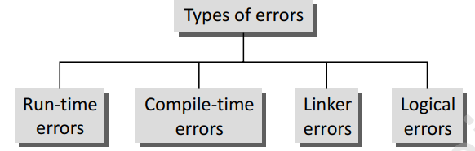
Go, change the world
RV College of
Engineering
TYPES OF ERRORS
While writing programs, very often we get errors in our program.
These errors if not removed will either give erroneous output or will not let the compiler to compile the program.

Slide 64
Go, change the world
RV College of
Engineering
Run-time Errors
As the name suggests, run-time errors occur when the program is being run executed. Such errors occur when the program performs some illegal operations like
Dividing a number by zero
Opening a file that already exists
Lack of free memory space
Finding square or logarithm of negative numbers

Slide 65
Go, change the world
RV College of
Engineering
Compile-time Errors
Again as the name implies, compile errors occur at the time of compilation of the program.
Such errors can be further classified as follows:
Syntax Errors:Syntax error is generated when rules of C programming language are violated.
Semantic Errors: Semantic errors are those errors which may comply with rules of the programming language but are not meaningful to the compiler
Logical Errors: Logical errors are errors in the program code that result in unexpected and undesirable output which is obviously not correct.
Linker Errors: These errors occur when the linker is not able to find the function definition for a given prototype.

